Slide 1

Finding Rise and Fall Time with the J750 IG-XL
Duration: 2.5 hr Theory
4 hr Lab
Objectives: * To understand the concept of using
characterization tools to measure the Rise
and Fall Time of a DUT
* To have an overview of the steps involved in
creating such a test

Slide 2
* Why AC Parametric Testing ?
The purpose of AC testing is to make
sure that the device meets all its timing
specifications.
* Typical AC parameters in a datasheet include:
-setup time
-hold time
-Propagation delays
-pulse width
-maximum operating frequency
-rise time
-fall time

Slide 3
* What do you need to consider when
performing timing test?
Measuring
between pins ?
Tester
Specifications ?
EPA=?
Data Specifications ?

Slide 4
Definition of Rise Time
Generally, rise time is the measurement of time
where a specified voltage of a pin rises from 10%
to 90% of its value .
Voh
90%
90%
10%
10%
Rise
Time
Vol
Fall
Time

Slide 5
Sample Datasheet Spec
Switching Characteristics
Vcc= +3.3V +10% , TA= -40 ºC to 85º C
Symbol
Parameter
Conditions
Min
Typ
Max
Units
t_{TLH}
Rise Time
CL = 15pF
CL=15pF
725
1000
ps
t_{THL}
Fall Time
600
1000
ps

Slide 6
To implement the Rise time Characterization you need to :
a) Modify the following IG-XL worksheets:
* Levels sheet
* Time set sheet
* Test instances sheet
* Characterization sheet
* Flowtable sheet

Slide 7
Create a functional pattern to characterize the actual vol and voh c) Create a functional pattern to characterize the rise time d) Create an interpose function to calculate the rise time and datalog the results

Slide 8
The 3 major steps involved:
Find the actual output voltage vol
and voh of the pin of interest
Overlay the actual vol and voh value
to locate the 10% and 90% point
3. Find the rise time of the pin of interest

Slide 9
Step 1 : Finding the actual output voltage vol
and voh of the pin of interest
through voltage characterization

Slide 10
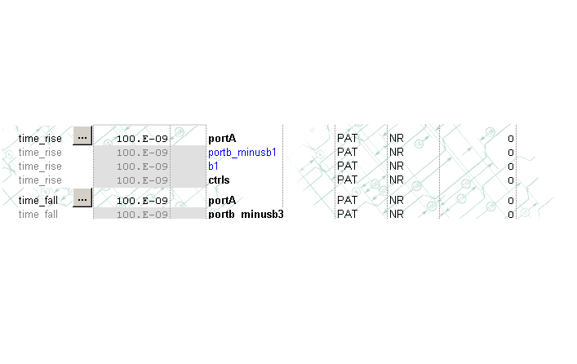
On the timeset sheet, list the pin “b1” separately from the rest of the
portB so that the characterization measure just uniquely adjust the
open edge of pin “b1” during characterization.

Slide 11
To characterize vol and voh :
5v
F
F
F
F
P
voh3
1.8v
1v
vol3
Characterizing
voh3
P
F
F
F
F
0v
Characterizing
vol3

Slide 12
* Create a characterization setup of type
“Adjust” called “lev_char”.
* Select search method as “Pos Linear”.
* For Voh characterization, search from 5V to 1V.
* For Vol characterization,search from 0V to 1.8V.
* Update the spec Vol3 and Voh3.

Slide 13
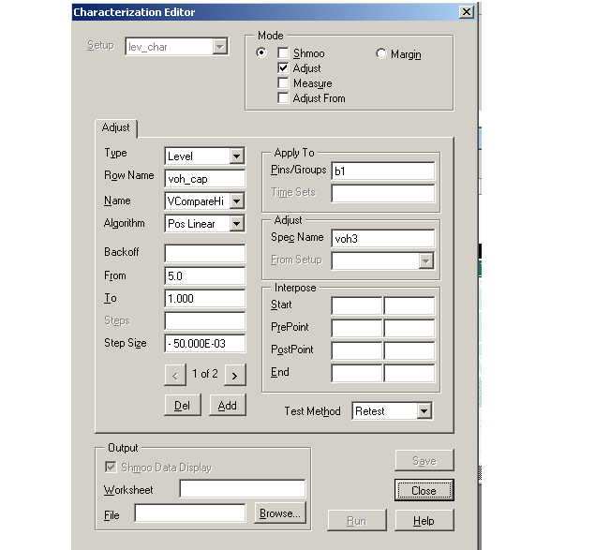
Characterizing Actual Voh Level
Setup name:lev_char
Pin = b1
Select Voh
Update spec voh3
Range from 5v to1v

Slide 14
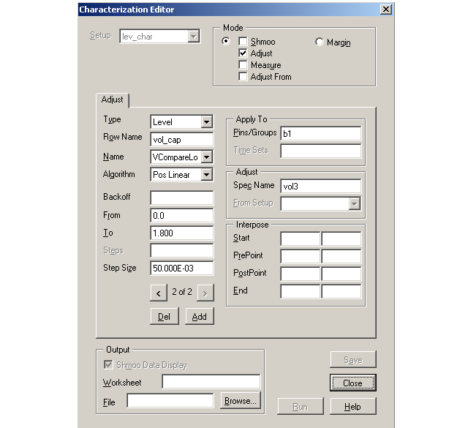
Characterizing Actual Vol Level
Setup name:lev_char
Pin = b1
Select Vol
Update spec vol3
Range from 0v to 1.8v

Slide 15
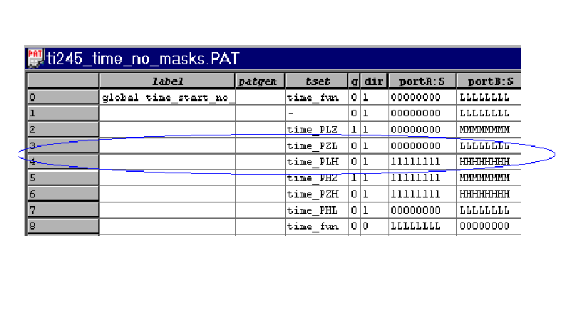
Setup uses a pattern that drives the
pin of interest from low to high

Slide 16
Step 2: Overlay the actual vol
and voh value to locate
the 10% and 90% point

Slide 17
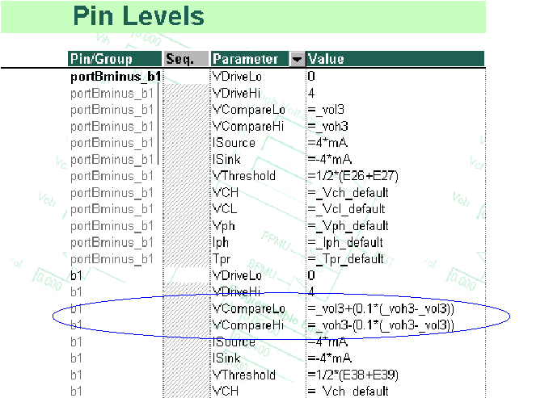
Create a new level sheet that uses spec voh3 and
vol3 (the actual output levels) to define the
10% and 90% compare levels for the pin of interest
Modify
Formula
for Vol & Voh

Slide 18
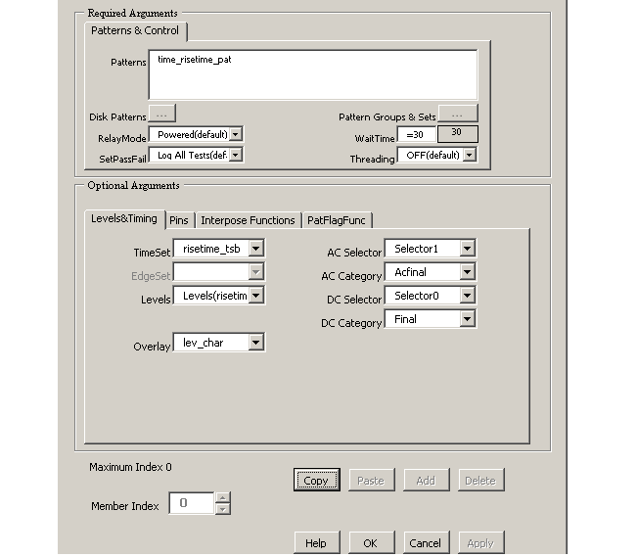
In the functional test instance for rise time
characterization, use the level worksheet created
in the previous slide and overlay the result from
the voltage characterization
Overlay lev_char

Slide 19
Step 3. Find the rise time of the
pin of interest through
timing characterization

Slide 20
To characterize the rise time
60ns<---100ns
P F F F F F F
90% pt
Expect Data =
Midband
10% pt
F F F F F F P
0ns-->50ns

Slide 21
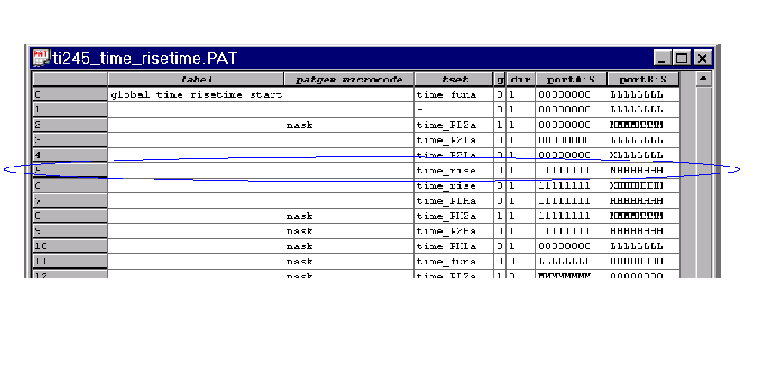
Modify the pattern to look for midband “M” to enable
rise time measure characterization to find the 10% and
90% levels during rise from Vol to Voh.

Slide 22
Create a test instance using the rise time pattern and
the overlay result of Vol3 and Voh3.
Special Rise time pattern
to look for midband
Level sheet where spec’s
Voh3 and Vol3 define
10% and 90% compare
levels for “b1”
Overlay

Slide 23
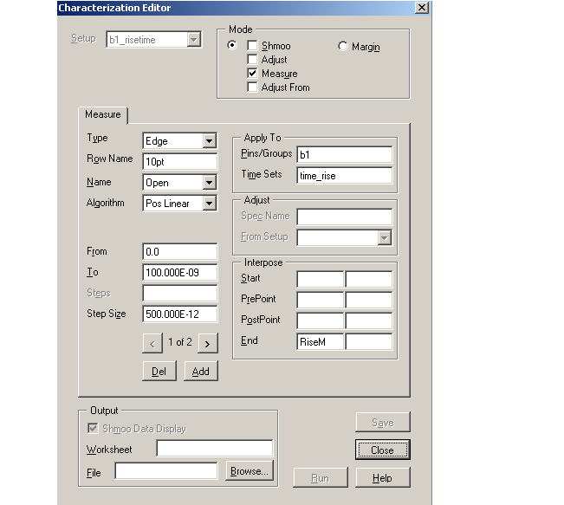
Characterizing 10% point for rise time
Interpose function
accesses measurement
by “10pt”
The first measurement
searches from 0ns to 100ns
to find the mid pass at
10% level
Interpose
Function to
Calculate
rise time

Slide 24
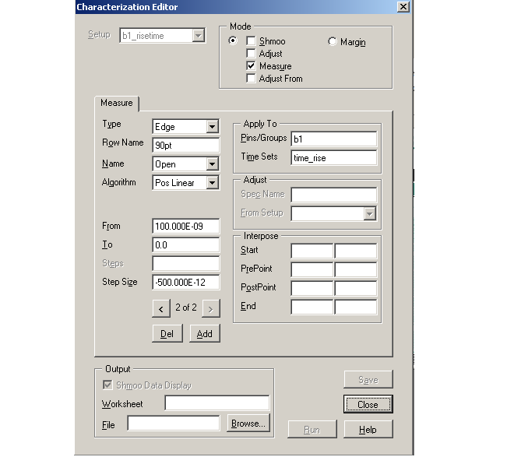
Characterizing 90% point for rise time
I
Interpose function
accesses measurement
by “90pt”
The second measurement
searches from 100ns to 0ns
to find the mid pass at 90%
level

Slide 25
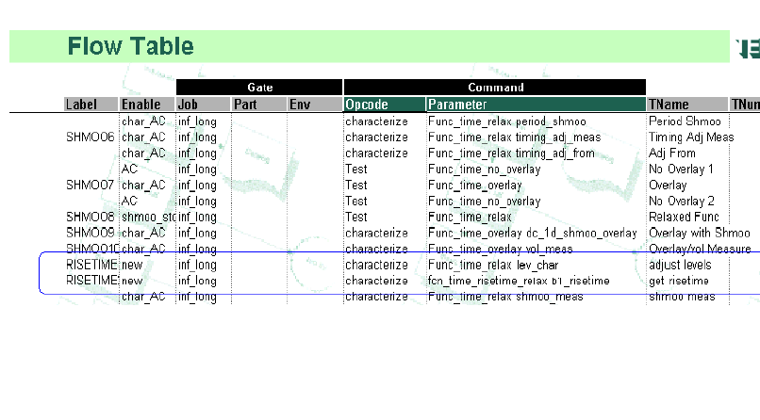
In the Flow table , the voltage characterization has
to be executed before the rise time characterization.

Slide 26
Visual Basic Code for interpose function
* Runtime Adjust Data Object (RTA)
After the test program executes a characterization
opcode in the Flow Table,the results of the operations
are available in a data object.
The VB-Test object RtaDataObj provides a way
to examine, modify and manipulate the results
of the characterization.
This result manipulation is usually done at the
end of the characterization . In this case, to
calculate the time between the 10% and 90%
point of the rising edge timing.

Slide 27
Using the RTA Data Object
The VB-Test object TheExec.DevChar.DataObjects
is a collection of the RtaDataObj objects, one for each
setup on the active Characterization sheet.
Declaring a user variable as an Rta Data Object
Dim dataobj As New RtaDataObj
Setting the object to point to a particular characterization setup
Set dataobj = theExec.DevChar.DataObjects(“setupname”)
Setting the object to point to the currently Active characterization setup
Set dataobj = theExec.DevChar.ActiveDataObject

Slide 28
To access a particular member of a collection, use the row name of the adjust or measure setup
Dim Startpt As Double
….
Startpt = theExec.DevChar.ActiveDataObject.MeasVals(“10pt”)
where 10pt is the row setup name of the current active characterization setup.

Slide 29
Interpose function to write a formatted parametric
test result to the datalog stream(s).
Call theExec.Datalog.WriteParametricResult(SiteNum,_
TestNum,TestFlag,ParaFlag,PinName,Channum,_
LowLimit,MeasVal,HiLimit,MeasUnits,ForceVal,_
ForceUnits,loc)

Slide 30
Where
TestFlag = Test Status (stdf defined system word)
logTestPass The test passed
logTestFail The test failed
logTestAbort The test aborted
logTestAlarm The test issued a hardware alarm
logTestNoExec The test did not execute
logTestNoPF The test did not generate a pass/fail result
logTestTimeOut The test timed out
logTestUnrel The test result was unreliable

Slide 31
Where
ParaFlag = Test Outcome (stdf defined system word)
parmScale The measurement was off scale
parmDrift The measurement drifted
parmOsc The measurement oscillated
parmHigh The measured value was higher than the high test limit
parmLow The measured value was lower than the low test limit
parmTestLim The test passes alternate limits
parmLowPass The test passes if the result equals the low test limit
parmHighPass The test passes if the result equals the high test limit

Slide 32
Where
SiteNum = Site number (Data type Long)
TestNum = Test Number (Data type Long)
PinName = Pin name (Data type String)
Channum = Channel number (Data type Long)
LowLimit = Lower test limit (Data type Double)
MeasVal = Actual measured value (Data type Double)
HiLimit = High test limit (Data type Double)
MeasUnits = units of measured value (eg. System word unitVolt)
ForceVal = Force value (Data type Double)
ForceUnits = Units of force value (eg. System word unitVolt)
loc = unknown (Data type Long)

Slide 33
The interpose function is called at the end of the rise time characterization setup to
* calculate the rise time by subtracting the time where ‘b1’ crosses the 90% point and the time where it crosses the 10% point
* datalog the results of the risetime measure characterization

Slide 34
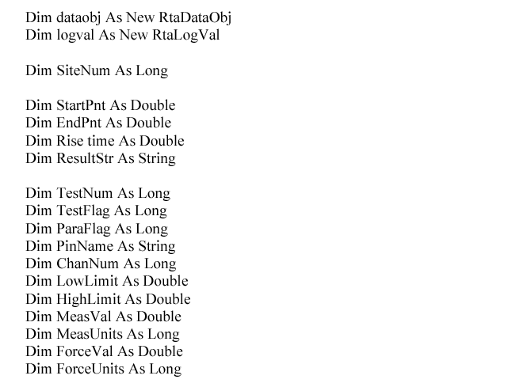
Sample interpose function

Slide 35
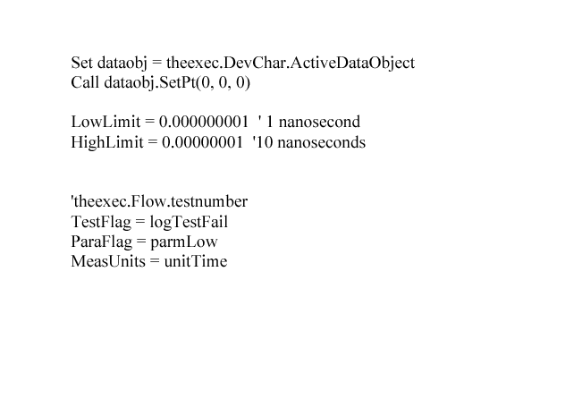

Slide 36
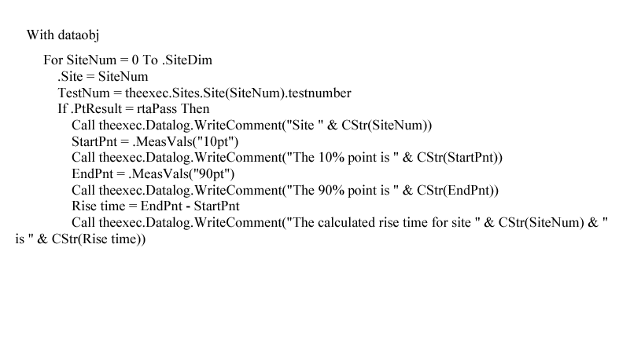

Slide 37
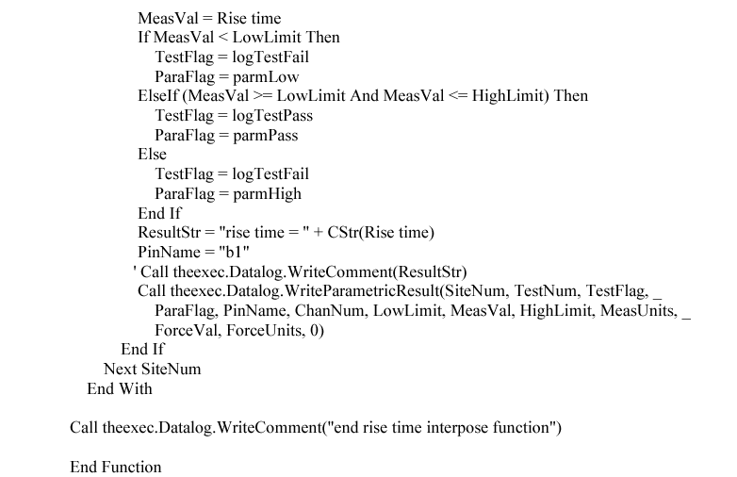

Slide 38
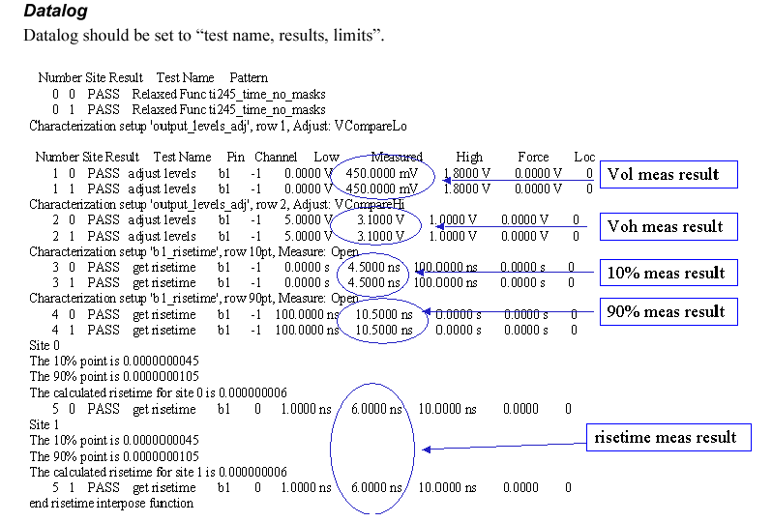
Sample datalog

Slide 39
Definition of Fall Time
Generally, fall time is the measurement of time
where a specified voltage of a pin falls from 90%
to 10% of its value .
Voh
90%
90%
10%
10%
Rise
Time
Vol
Fall
Time

Slide 40
The 3 major steps involved:
Find the actual output voltage vol
and voh of the pin of interest
Overlay the actual vol and voh value
to locate the 90% and 10% point
3. Find the fall time of the pin of interest

Slide 41
To characterize the fall time
0ns----->50ns
F F F F F F P
90% pt
Expect Data =
Midband
10% pt
P F F F F F F
60ns<-------100ns

Slide 42
Since we have already found the actual vol
and voh level, the procedure will be fairly similar
to that of finding the rise time.
We are still looking for the midband region
but for a pattern that transit from High to Midband.
As for the characterization setup, the 90% point
will be searched from 0ns to 100ns and the 10% point
will be searched from 100ns to 0ns.

Slide 43
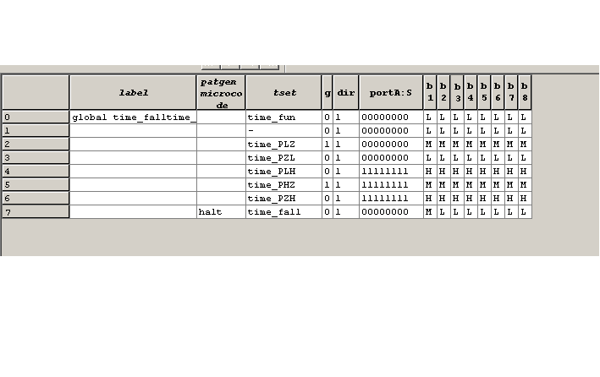
Pattern for finding the fall time of “b1”
Pattern for b1 changes
From “H” to “M”

Slide 44
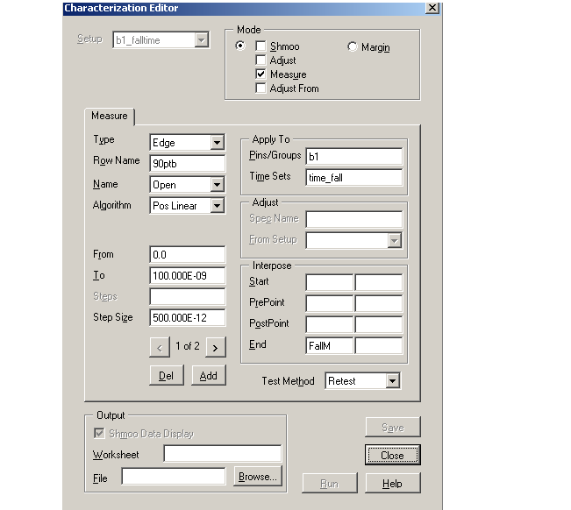
Characterizing the 90% point for fall time
The first measurement
searches from 0ns to 100ns to find the mid pass at 90% level

Slide 45
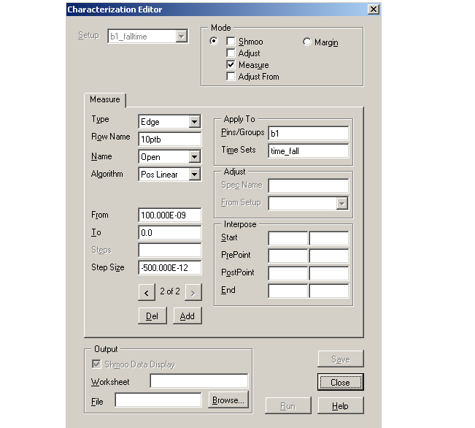
Characterizing the 10% point for fall time
The first measurement
searches from 100ns to 0ns to find the mid pass at 10% level

Slide 46
The fall time can be calculated by
Time where ‘b1’ crosses the 10% minus
Time where ‘b1’ crosses the 90% point of the voltage
This can be implemented similarly with the interpose
function.

Slide 47
Lab Session (4 hr)
Load the program rftlab.xls. This program is able to test the rise time
of “b3”pin of the device.
B. Study the program to understand how the find the rise time of “b3”
C. Modify the program to add a test to test the fall time of the device “b3” pin
and debug it on the tester.
Note: You may need to:
a. Create a pattern to look for the correct state when testing fall time
(Pattern must have a state from High to Midband for “b3”)
b. Create a new timeset call time_fall
c. Create the functional instance to do a functional test using this pattern
and with the overlay of the level characterization “lev_char”
d. Create the characterization setup to search for the 90% and 10% point of the
falling edge.
e. Create the VB function
f. Observe the change in the compare level after the voltage characterisation
using the digital channel display.

